Slide 1

Roslyn
Workshop
Rainer Stropek
software architects gmbh
Web
Mail
Twitter
http://www.timecockpit.com
rainer@timecockpit.com
@rstropek
.NET Compiler Platform

Slide 2
Roslyn
Compiler-as-a-Service

Slide 3
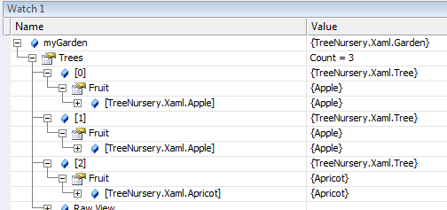
From Text to Tree
<Garden […]>
<Garden.Trees>
<Tree>
<Tree.Fruit>
<Apple />
</Tree.Fruit>
</Tree>
<Tree>
<Tree.Fruit>
<Apple />
</Tree.Fruit>
</Tree>
<Tree>
<Tree.Fruit>
<Apricot />
</Tree.Fruit>
</Tree>
</Garden.Trees>
</Garden>
Parser
XAML → Object- tree in memory

Slide 4
Von Text zum Baum
Sequentieller Inhalt mit Struktur
Baumstruktur im Speicher
Sequentielle Ausgabe
Operationen

Slide 5
Examples
Lexer/Parser
XML in DOM
SQL in Execution Plan
Compiler, Lexer/Parser/Generator
C# in IL
FetchXML in SQL (MS CRM)
Interpreter
SQL Server Execution Plan
Compiler-Compiler
ANTLR
Coco/R

Slide 6
Wo ist der Baum?
X=5 And ( Y=7 Or Z=3 Or Y=5 )
&&
==
||
X
5
||
==
Y
5
==
==
Y
7
Z
3

Slide 7
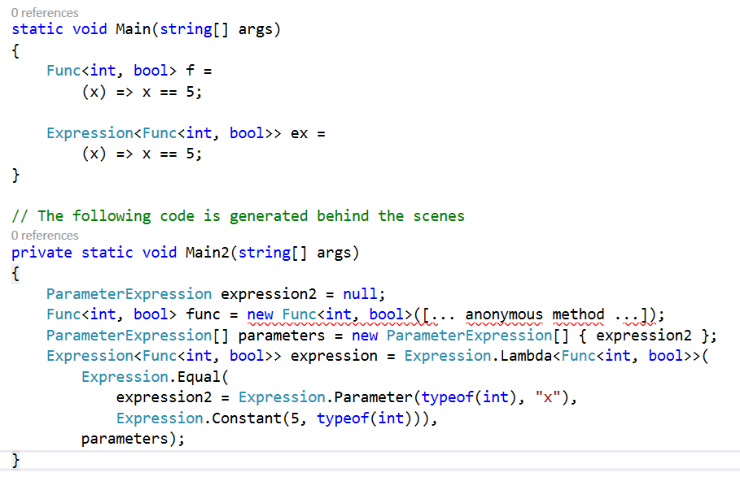
Expression Trees in C#
Compiler lets you access syntax tree during runtime

Slide 8
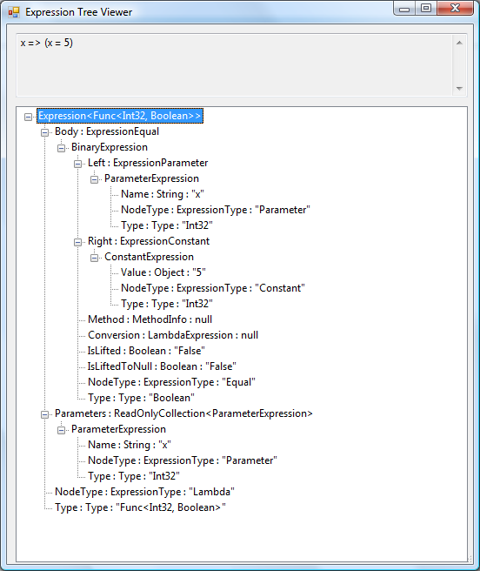
Expression Trees in C#
Func<int, bool> f =
(x) => x==5;
Expression<Func<int, bool>> ex =
(x) => x == 5;

Slide 9
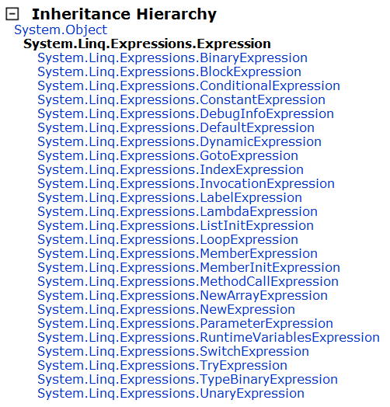
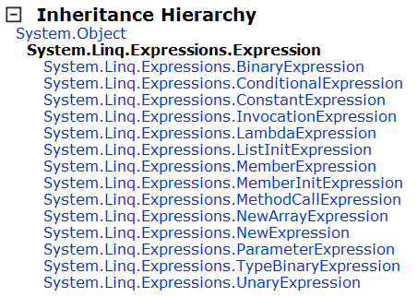
Expression Trees in C#
2012
2008

Slide 10
Roslyn
Re-write of C# and VB compiler in C# and VB
Multi-year preview, launch will be in VS2015
Open source, cross platform
Opening the compiler platform
Compiler-as-a-Service
Write applications that can understand C# and VB source code
Revolutionizes writing tools that act on source code-level
NuGet Roslyn Compiler Package
Microsoft.CodeAnalysis
Language-specific packages for C# and VB

Slide 11
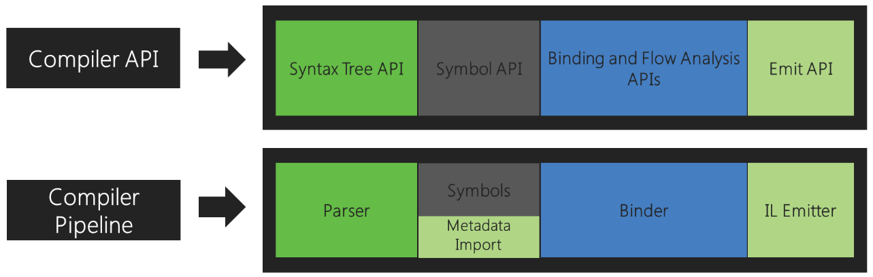
Roslyn
Compiler API Structure
Syntax Tree API/Parser
Lexer (source is tokenized)
Syntax parser based on grammar
→ Syntax Tree (e.g. code formatting)
Symbols
Symbols analyzed from source
Hierarchical Symbols Table (e.g. Object Browser)
Binding
Identifiers are matched to symbols
Emit
Assembly generation
(e.g. Edit-and-Continue)
Image source: https://github.com/dotnet/roslyn/wiki/Roslyn%20Overview#introduction

Slide 12
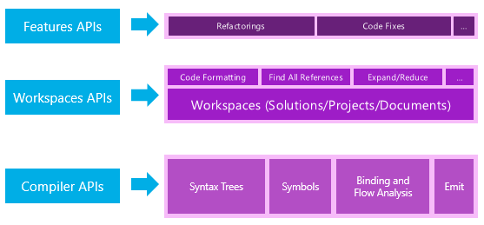
Roslyn
Workspace API
Object model for project and solution structure
No dependencies on VS
Not in the scope of this workshop
Image source: https://github.com/dotnet/roslyn/wiki/Roslyn%20Overview#api-layers

Slide 13
Roslyn Syntax Tree
Process the syntactic structure of source code
Syntax tree even contains errors and e.g. information about skipped tokens
Create, modify, and rearrange source code
No need to edit text directly
Code is changed by creating and manipulating trees
Completely round-tripable
Immutable and thread-safe
Each change to the tree is done by creating a new snapshot
Tree nodes are reused in the background

Slide 14
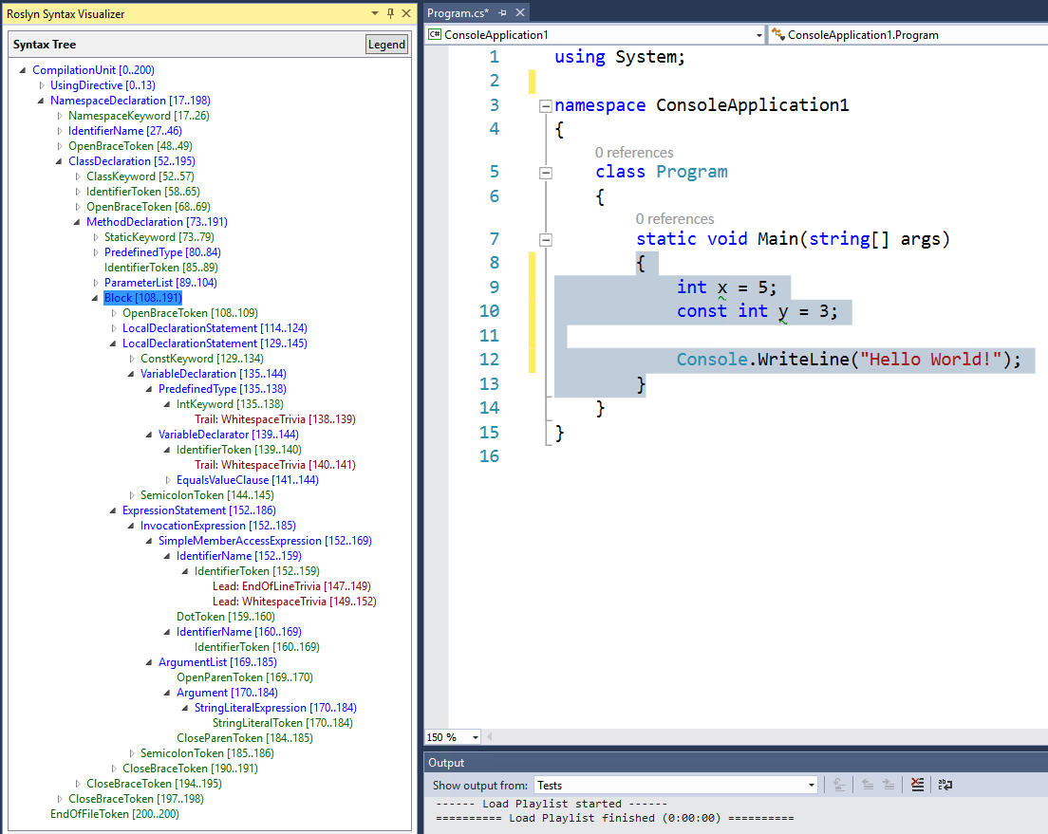
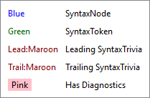
Syntax Tree
Tip: Syntax Visualizer

Slide 15
Syntax Nodes
Syntactic constructs
E.g. declarations, statements, clauses, and expressions
Derived from SyntaxNode class
Class names: …Syntax (e.g. InvocationExpressionSyntax)
Non-terminal nodes
All syntax nodes have children (ChildNodes property, Parent property)

Slide 16
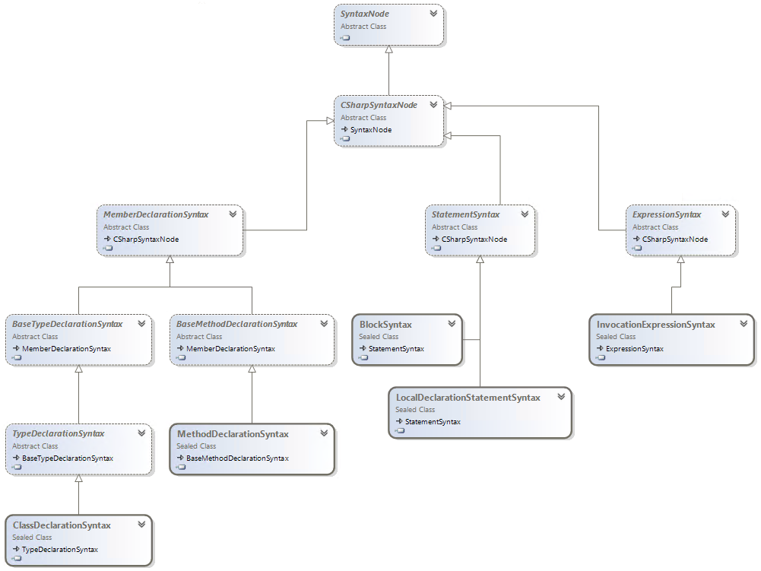
Syntax Nodes
Excerpt from syntax node class diagram

Slide 17
Syntax Tokens
Terminal nodes
Smallest syntactic fragment of the code
E.g. keywords, identifiers, literals
SyntaxToken struct
Because of performance reasons a value type

Slide 18
Syntax Trivia
Insignificant for understanding the code
E.g. whitespace, comments, preprocessor directives
SyntaxTrivia struct
Because of performance reasons a value type
Access from token
Via LeadingTrivia/TrailingTrivia collections
Not part of the syntax tree → no parent
Find associated token using Token property

Slide 19
Spans
Represents position of node/token/trivia
Zero-based Unicode character index + char count (TextSpan)
Char count can be zero to indicate location between two characters
Span vs. FullSpan
Span is without surrounding trivia, FullSpan with

Slide 20
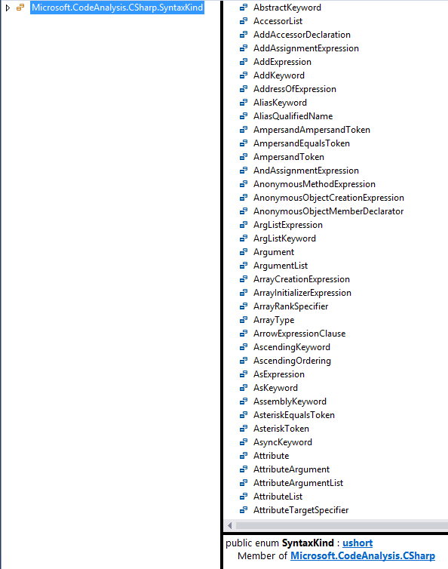
Kinds
RawKind property (Int32)
Enum SyntaxKind
Language-specific
Use CSharpSyntaxKind() extension method for conversion

Slide 21
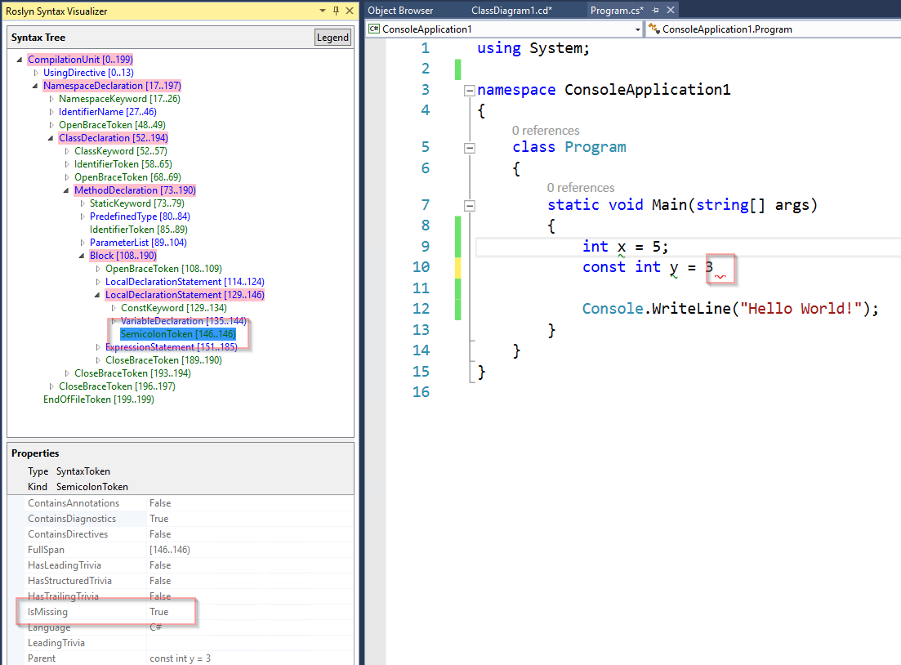
Errors
Missing tokens

Slide 22
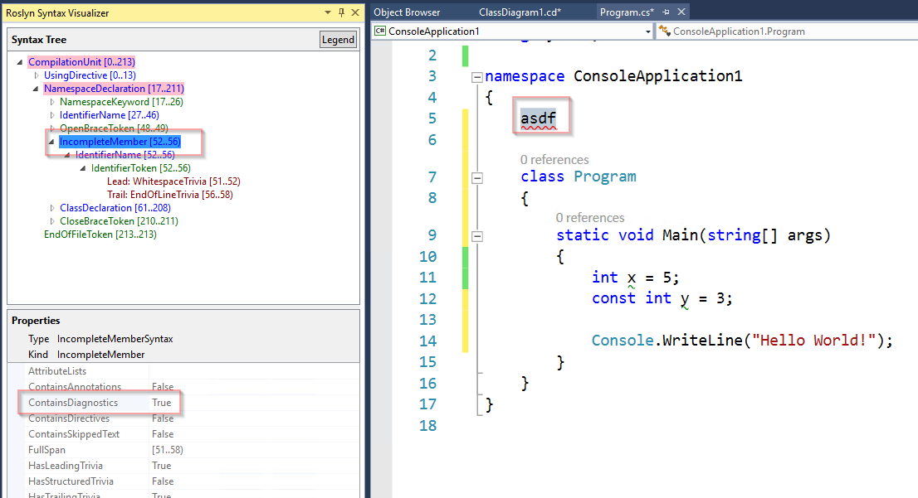
Errors
Incomplete Member Example

Slide 23
Semantics
Syntax tree is not enough
E.g. variables with identical name, var declarations, etc.
Semantic model offers a solution
Compilation
Symbols
SemanticModel

Slide 24
Compilation, Semantic Model
Compilation = everything needed to compile a C# program
E.g. assembly references, compiler options, and source files
Immutable
Compilation can be based on an existing one (e.g. additional source file)
Semantic model
Semantic information for a single source file

Slide 25
Symbols
Sources
Declared by the source code
Imported from an assembly as metadata
Namespace, type, method, property, field, event, parameter, local variable
Derived from ISymbol
E.g. IMethodSymbol, ILocalSymbol

Slide 26
Roslyn Demos
See GitHub Samples Repo

Slide 27
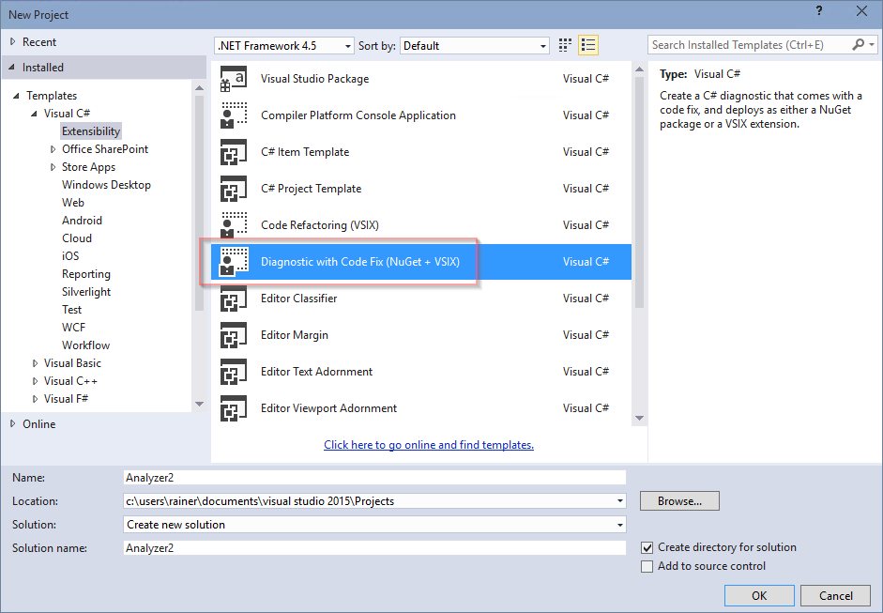
Advanced Topics
Diagnostics and fixes
Download .NET Compiler Platform SDK Templates for CTP5

Slide 28
Q&A
Workshop
Rainer Stropek
software architects gmbh
Mail Web Twitter
rainer@timecockpit.com http://www.timecockpit.com @rstropek
Thank your for coming!

